Slide 1
Min Graph Coloring Approximation Solution
John Curley

Slide 2
How The Approximation Works
The algorithm runs recursively, each iteration it finds the node with the max number of edges and removes it and all the edges coming out of it. For each edge removed we increase the count color by 1.

Slide 3
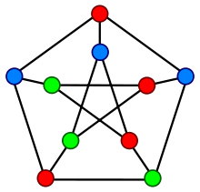
Not Always Optimal
The Graph to the right’s optimal solution is 3 however in our approximation the yielded solution ends up being 7

Slide 4
Run Time Results (Scripts)

